Slide 1
A core Course on Modeling
Introduction to Modeling
0LAB0 0LBB0 0LCB0 0LDB0
c.w.a.m.v.overveld@tue.nl
v.a.j.borghuis@tue.nl
S.2

Slide 2
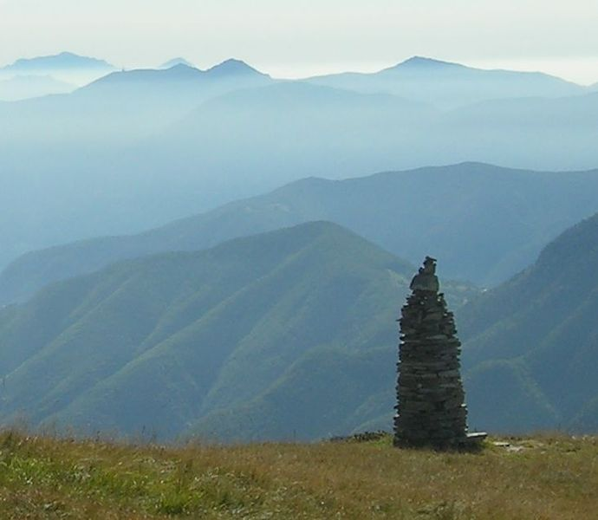
http://commons.wikimedia.org/wiki/File:DryStoneMarkingB.jpg
Notes:
2
This photo was taken, in 2006, near the Swiss-Italian border by a photographer called Audrias Meskausas. He submitted it to Wikimedia, and filed a subscription ‘stone marking with unknown purpose’.

Slide 3
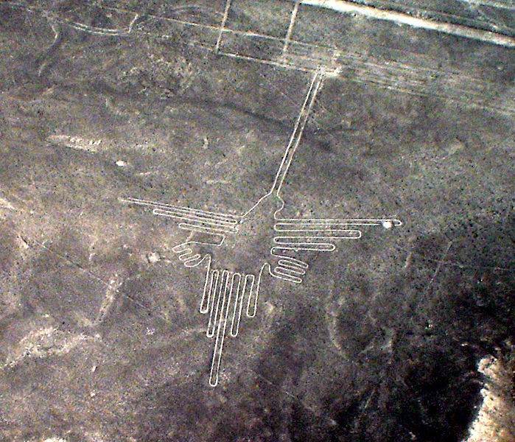
http://commons.wikimedia.org/wiki/File:Lignes_de_Nazca_D%C3%A9cembre_2006_-_Colibri_2.jpg
Notes:
3
The world is full of things with unknown purpose. A famous example are the so-called Nazca-lines, a pattern of drawings streching some 80 kilometers across on a deserted plane in Peru, presumably originating in the 5th to 7th century AD. Nobody knows what these lines are for. It is clear that they were man made. It must have required significant effort to produce them, so much we can tell from their sheer size and the accuracy with which the lines were made in the soil. This indicates a clear and urgent purpose. But there is nobody whe can ask what precisely this purpose was.

Slide 4
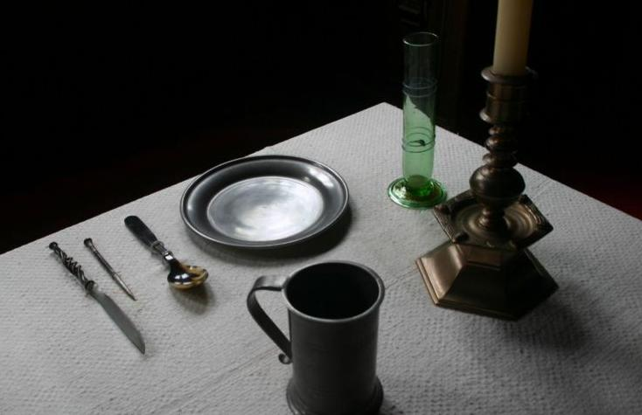
To find the purpose of something,
pretend that it is absent:
what can no longer be done?
http://commons.wikimedia.org/wiki/File:Bordopd%C3%A6kning_(17.%C3%A5rh.).JPG
Notes:
4
Sometimes it is easy to find what the purpose of something is. Simply imagine what would happen if the thing, for which you try to find the purpose, would not exist. If it does have a purpose, you will find that something will no longer be possible. Or something will get more complex, awkward or clumsy. That what gets more clumsey without a spoon is eating soup – therefore a purpose of a spoon is eating soup.
We may try the same trick to find out the purpose of models.
If we think that X is a model of Y, imagine that we have to do without X. What, in relation to Y, becomes impossible if X is absent? That what is no longer possible without X apparently was X´s purpose.
In this way, we easily find that the purpose of a menu – as a model of food – is to help deciding what to dish eat, and a menu – as a model of films – is to help deciding what film to watch. When we look a bit closer, we see that the purposes are a bit more subtle: the menu also informs about prices, and therefore allows us to verify if we have enough money to order our favorite dish; the agenda gives starting times and therefore specifies at what time we need to be present in the cinema. You may want to find out for yourself what the exact purposes are for the other items that were suggested in the scene: a receipt as a model of a meal, and a review as a model of a film. Each time you should apply the same method: pretend that the receipt, or the review are missing: what can no longer be done?

Slide 5
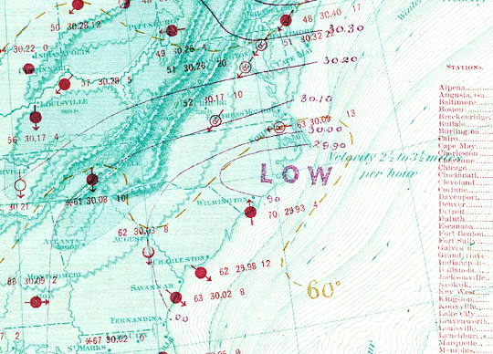
Notes:
5
Let us look into another example. If you believe that a weather map is a model of the weather, pretend that there would be no weather map. What would happen than?
Would it stop raining, or would the weather no longer change?
That is clearly not the case. So a weather map is not simply a model of the weather with the purpose to behave exactly the same as the weather does.

Slide 6
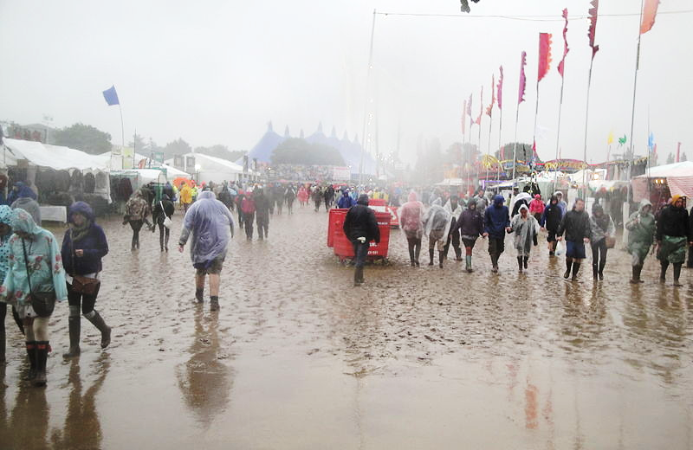
http://commons.wikimedia.org/wiki/File:Isle_of_Wight_Festival_2011_during_bad_weather_17.JPG
Notes:
6
Instead, if there would be no weather map, we for instance couldn’t decide what clothing we should wear if we plan to visit tomorrow’s festival. So, a weather map could be thought to have the purpose to support decisions as to what to wear at a certain place at a certain time.
For a system to advise us what to wear, a weather map in the familiar form – indicating areas of high and low pressure, wind directions and temperature distributions - is clearly unsuitable. It requires sophisticated expertise to interpret these data, and most people would be incapable to do so. From just looking at the weather map the lay person can´t tell what to wear tomorrow. Instead a simply showing an icon of a cloud with some raindrops, or, alternatively, the sun would be more appropriate.
On the other hand, sailors, farmers or parachute jumpers might not be helped very much with a mere graphical icon indicating just sun or rain. These users might benefit from a model that gives quantitative information such as expected amounts of rain, wind speeds and more precise timing estimates.
Seeking the purpose of a model therefore inevitably involves the question for the intended users and the intended usage: who will benefit from the results of the model, and how.
To ask such questions should be the modeler’s first responsability; to answer them, we need to look a bit deeper in the kinds of purposes models could have.

Slide 7
QUIZ
A progress bar such as this,
indicating how long something on a computer will last, can be seen as a model of something.
Formulate precisely what it is for by imagining that it would not exist.
Once you understand what it is for, suggest an improvement.
Do the same for other widgets or icons you find on your computer.
Notes:
7
Instead, if there would be no weather map, we for instance couldn’t decide what clothing we should wear if we plan to visit tomorrow’s festival. So, a weather map could be thought to have the purpose to support decisions as to what to wear at a certain place at a certain time.
For a system to advise us what to wear, a weather map in the familiar form – indicating areas of high and low pressure, wind directions and temperature distributions - is clearly unsuitable. It requires sophisticated expertise to interpret these data, and most people would be incapable to do so. From just looking at the weather map the lay person can´t tell what to wear tomorrow. Instead a simply showing an icon of a cloud with some raindrops, or, alternatively, the sun would be more appropriate.
On the other hand, sailors, farmers or parachute jumpers might not be helped very much with a mere graphical icon indicating just sun or rain. These users might benefit from a model that gives quantitative information such as expected amounts of rain, wind speeds and more precise timing estimates.
Seeking the purpose of a model therefore inevitably involves the question for the intended users and the intended usage: who will benefit from the results of the model, and how.
To ask such questions should be the modeler’s first responsability; to answer them, we need to look a bit deeper in the kinds of purposes models could have.

Slide 8
Summary:
Every model has a purpose
The purpose of model X for system Y:
That what cannot be done or known with respect to Y if X is absent
To find this purpose, first ask who will benefit and why.
Notes:
8
The answer to the last question informs us about the so-called stakeholders: people, or institutions who have an interest in the model and its outcomes.

